Slide 1
Mini Presentation 7
11 September 2020

Slide 2
Sentiment Analysis of Covid-19 in SG and HK
Objective
Sentiment analysis of the Covid-19 situation in Singapore and Hong Kong
Period of analysis
19 August 2020 to 2 September 2020
Dataset
Random selection of 5 news articles from 3 media namely CNA, SCMP and YahooNews
Total 15 articles selected, 8 on Singapore and 7 on Hong Kong
Articles are captured in Excel Spreadsheet and loaded as a DataFrame in ipython notebook

Slide 3
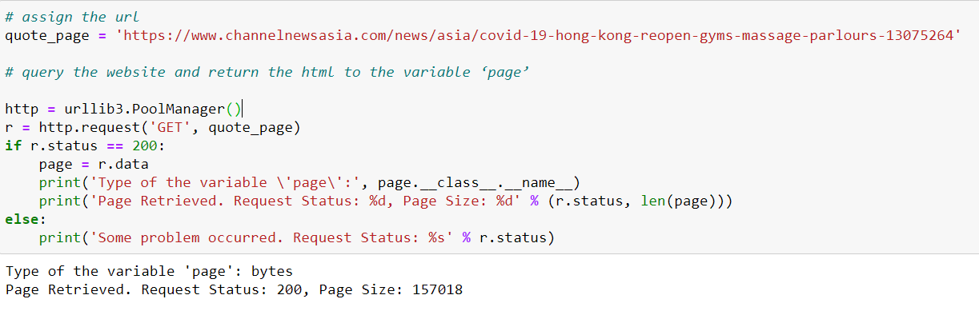
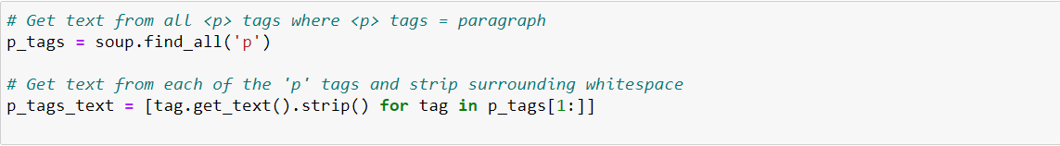
Web Scraping
Used BeautifulSoup to extract the content of URL

Slide 4
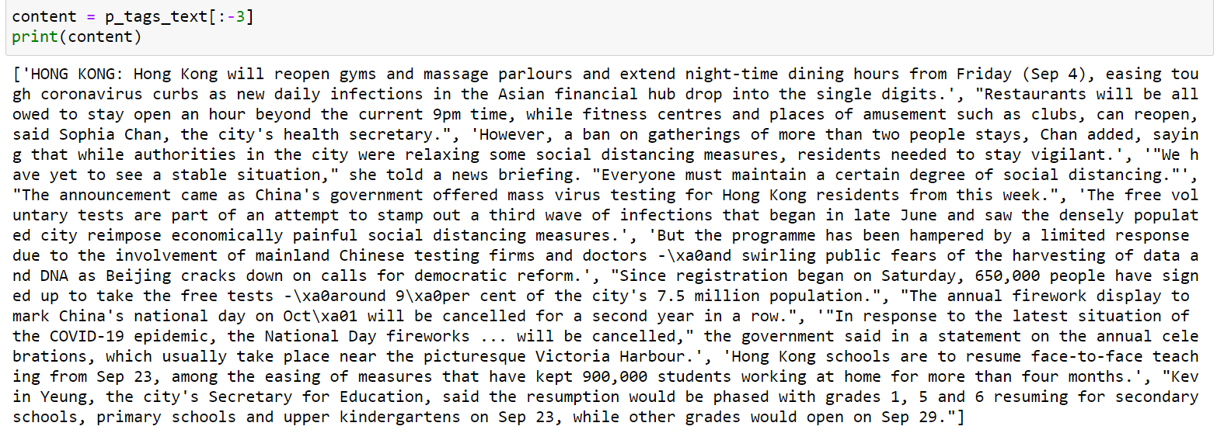
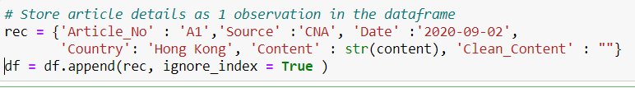
Web Scraping – Extracted Content

Slide 5
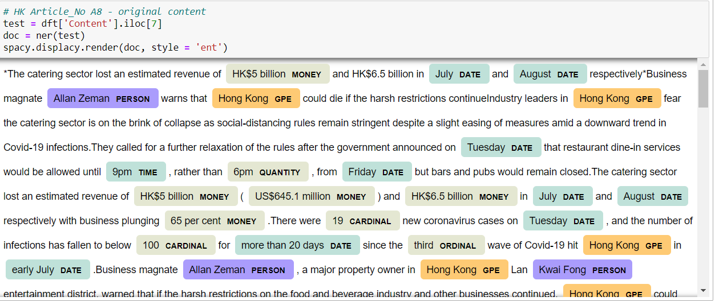
Named Entity Recognition (NER)
Used Spacy for NER analysis
NER analysis on a HK article (A8) where tagging is generally in good order

Slide 6
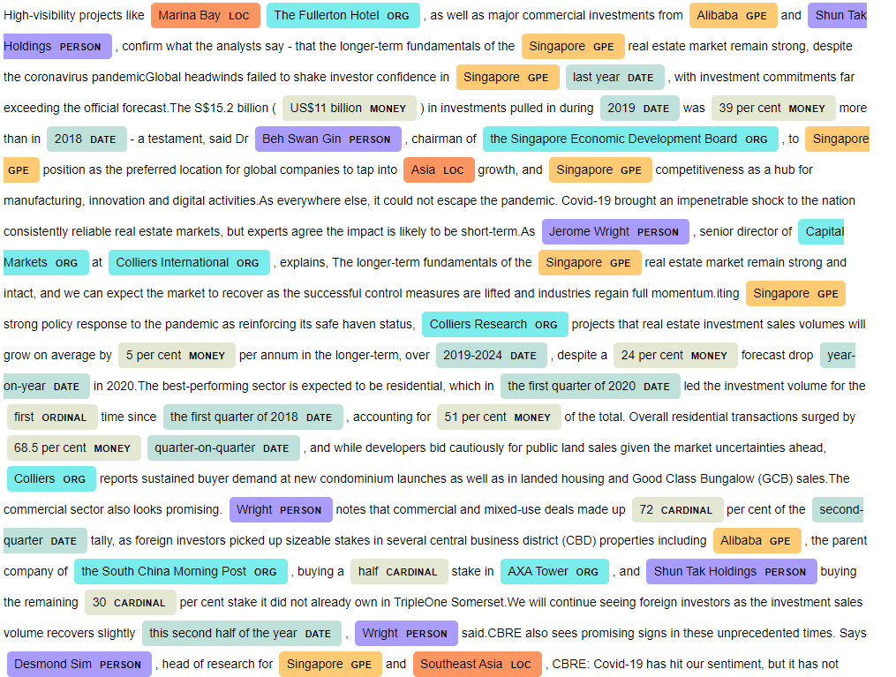
NER – SG article
NER analysis on a SG article (A3) where tagging is slightly off for companies

Slide 7
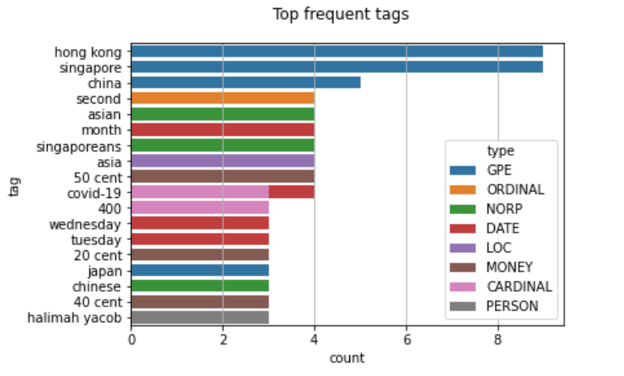
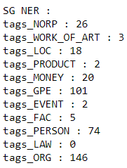
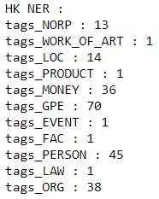
NER – Top Frequency Tags
NER analysis on the entire dataset (Content column)
Not surprising since the articles are about HK and SG

Slide 8
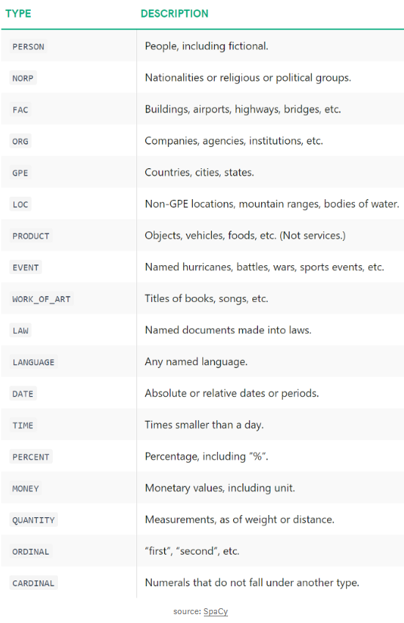
NER Tag Types

Slide 9
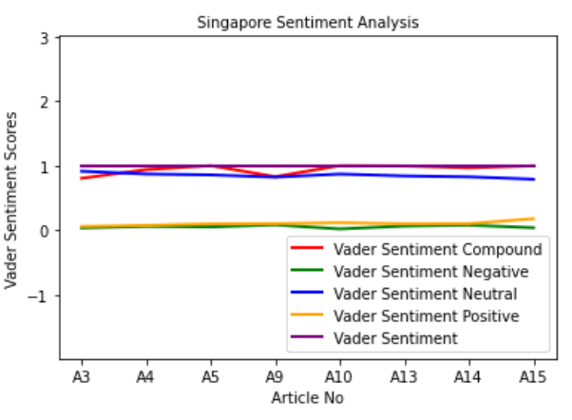
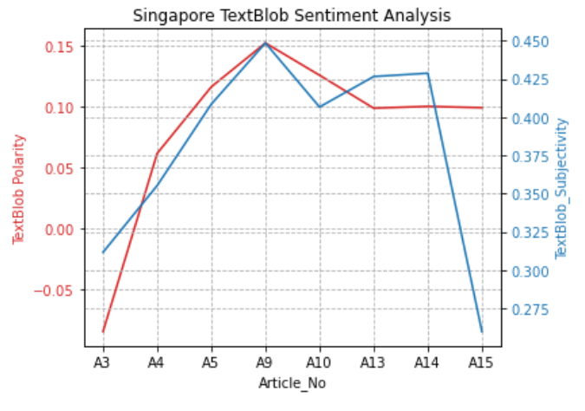
Sentiment Analysis - Singapore
Overall sentiment for SG is Neutral with Vader’s high neutral score & TextBlob Polarity hovers around 0.
Vader Sentiment
Assign 1 i.e. Positive if Vader Sentiment Compound >= 0.05
Assign -1 i.e. Negative if Vader Sentiment Compound <= -0.05
Assign 0 otherwise
The Positive, Negative and Neutral scores represent the proportion of text that falls in these categories. Compound score is a metric that calculates the sum of all the lexicon ratings which have been normalized between -1(most extreme negative) and +1 (most extreme positive).
Polarity lies in the range of [-1,1]
1 means positive statement
-1 means a negative statement.
Subjectivity lies in the range of [0,1]
Subjective sentences generally refer to personal opinion, emotion or judgment
Objective refers to factual information.

Slide 10
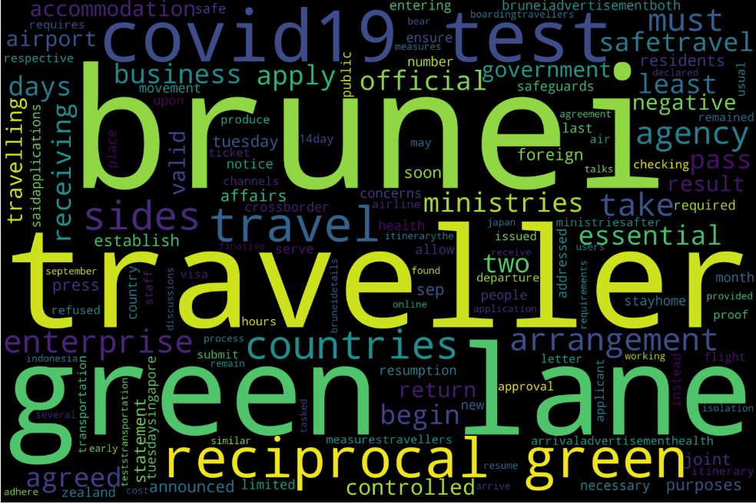
Sentiment Analysis Challenge – Context & Polarity
SG Article A3 reported on the approved green lane between Singapore and Brunei
When checking in at the Brunei airport, travellers will have to produce a valid SafeTravel Pass, the negative COVID-19 test, a valid return air ticket or proof of other transportation arrangements to return to Brunei to the airline staff
After an approval letter is issued, the enterprise or agency will have to submit the traveller's negative COVID-19 test result and a controlled 14-day itinerary.

Slide 11
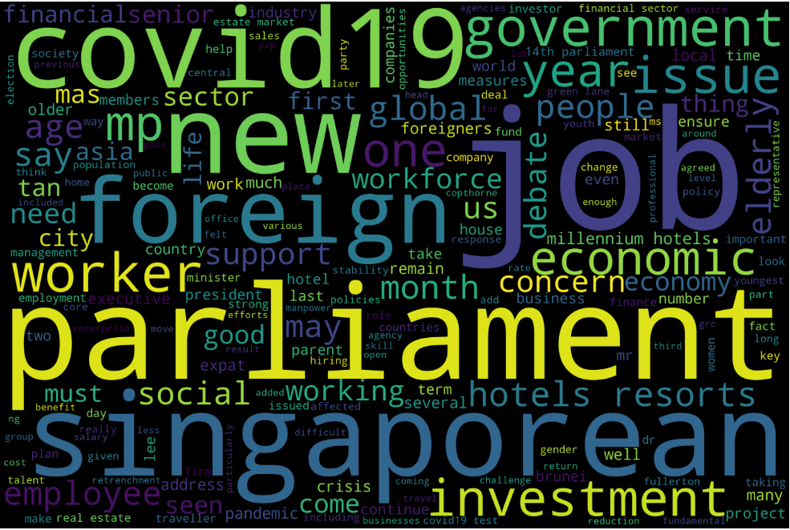
Word Cloud – SG articles
Common words in the 8 articles

Slide 12
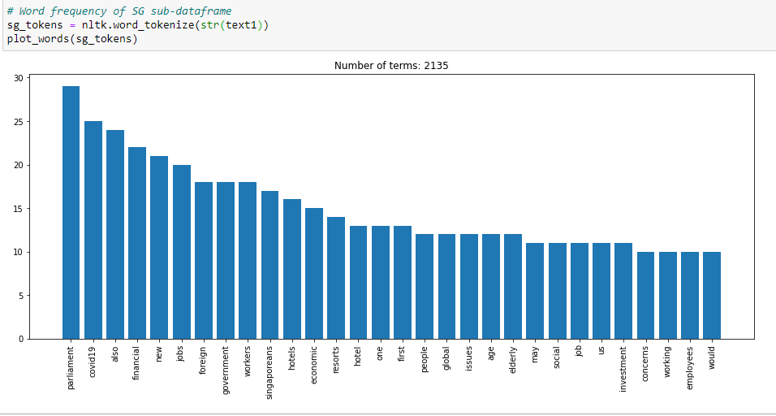
Bar Chart - Common Words in SG articles

Slide 13
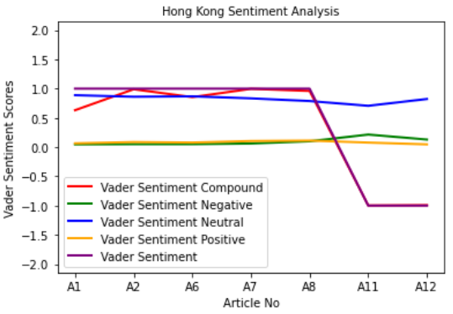
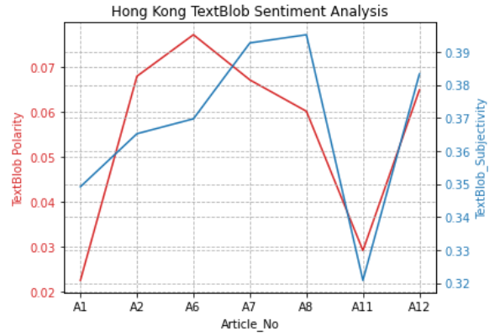
Sentiment Analysis – Hong Kong
Sentiment for HK is mainly Neutral except for A11 and A12
Neutral sentiments for articles A1, A2, A6 and A8
Negative sentiments for articles A11 and A12
Sentiments are neutral across all articles

Slide 14
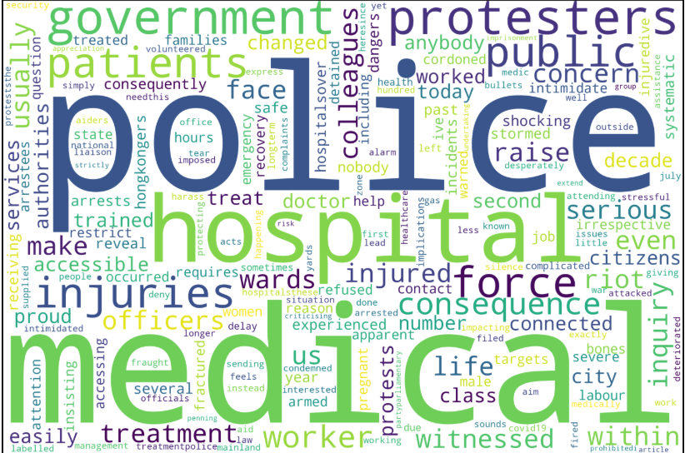
Sentiment Analysis – HK Article 11
YahooNews article on 2 Sep – A report by HK doctor on HK police’s treatment of patients whom were protesters
Abstract of article
Since the National Security Law was imposed in Hong Kong
on 1 July 2020, the situation has further deteriorated. The
government's Liaison Office has condemned healthcare
workers who express their concern about sending Covid-
19 medical aid supplied by the mainland to Hong Kong. The consequences for giving medical assistance to protesters could now lead to life imprisonment. Just by penning this article I risk my life, as criticising the government or the police is now strictly prohibited.
An outlier of the dataset !
Vader sentiment analysis is Right

Slide 15
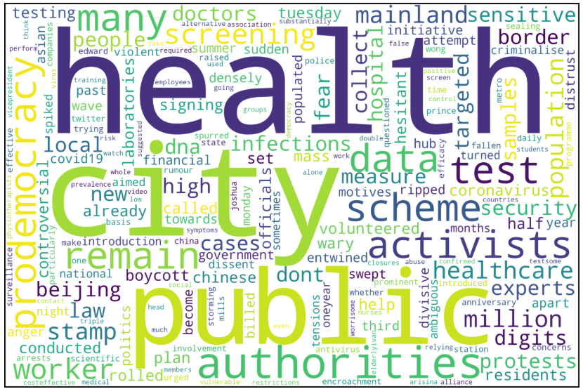
Sentiment Analysis – HK Article 12
YahooNews article on 31 Aug – A report on the boycott of coronavirus mass testing plan by Hong Kong pro-democracy activists and healthcare workers
Vader sentiment analysis is Negative
vs
TextBlob analysis is Neutral
Which is correct ?

Slide 16
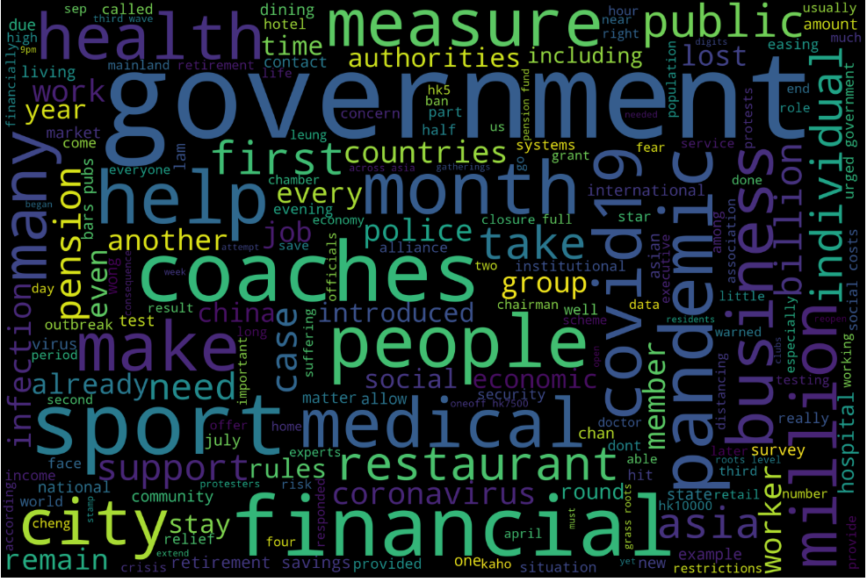
Word Cloud – HK articles
Common words in the 7 articles

Slide 17
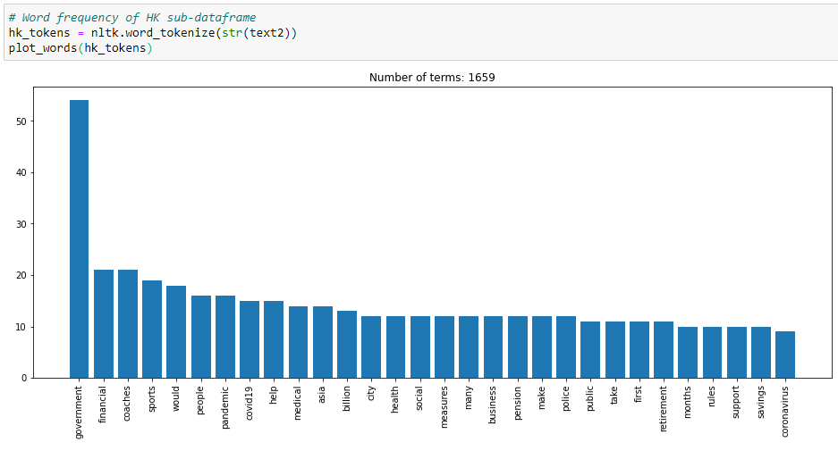
Bar Chart - Common Words in HK articles

Slide 18
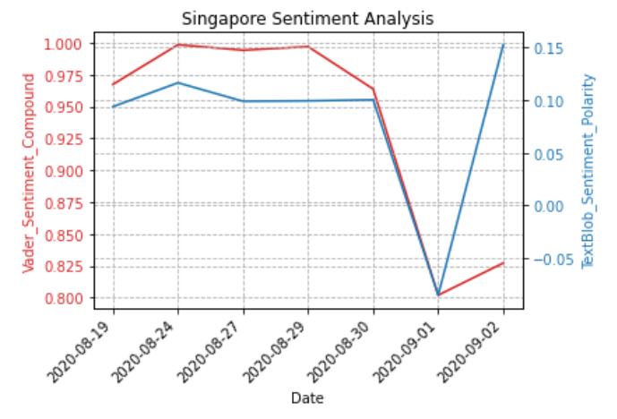
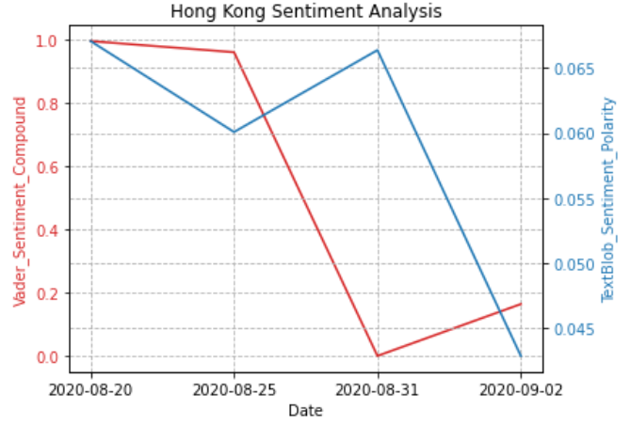
Sentiments across the period
Mean scores applied for articles that fell on same date
2 SG articles on 19 Aug
2 HK articles on 31 Aug
3 HK articles on 2 Sep

Slide 19
Conclusion
Common words or related terms in both SG and HK with high frequencies :
Government
Financial
Social
People
Business (HK) / Investments (SG) / Economics (SG)
Jobs (SG) / Coaches (HK)
Employees (SG) / Workers (SG) / Pension (HK)
Sentiment analysis in both SG and HK is generally neutral with the exception of :
An outlier, article A11
Inconsistent analysis between 2 sentiment analysis methods for article A12
NER analysis shows the Covid-19 impacted across people, organisations, countries, financial
In conclusion, both countries face similar concerns, to different extents, on people, social, financials, jobs. Government of both countries are playing an active role in managing the crisis.

Slide 20
Appendix

Slide 21
NLP
https://www.spglobal.com/marketintelligence/en/documents/spgmi732_measuring-sentiments-during-the-covid-19-outbreak.pdf Mini-Presentation on Tue (8 Sep) Use of Spacy on news articles. Select 5 articles each from the media - CNA< SCMP and Yahoo News on covid-19 Spread the 5 articles over a period 2 weeks. Do the following NLP analyses on the articles i. DO a sentiment analysis on the articles (use the library Vader and/or TextBlob ii. DO a NER on the articles The NER needs to includes events + organisations/ people iii. After doing the analysis, comment on how the sentiment has varied over the last 2 weeks and across the different regions - HK and Singapore Use the spacy library Also, comment on how the different entities have changed n the period. THe 5 articles are just a minimal

